Slide 1
What we will discuss
Agenda
Programmatically Interacting with the API
Kubernetes Objects in Go
In vs Out of Cluster Authentication
ClientSets
API Machinery
Informers and Caching
Guidelines for Writing Controllers

Slide 2
Client Libraries
Programmatically Interacting with the API
https://github.com/kubernetes-client
client-go
kubernetes-client
Python
Java
dotnet
JavaScript
Haskell
Notes:
client-go is a collection of tools/frameworks in the form of Go packages for all your Kubernetes programming needs. client-go provides the most features and compatibility when working with Kubernetes.

Slide 3
Kinds are represented as Golang structs; usually in a package whose path corresponds to the GVK
pkg/apis/group/version/types.go
Deployment for example is found in: k8s.io/kubernetes/apps/v1/types.go
Programmatically Interacting with the API
Notes:
k8s.io is github.com/kubernetes

Slide 4
// Deployment provides declarative updates for Pods and ReplicaSets.
type Deployment struct {
metav1.TypeMeta
// +optional
metav1.ObjectMeta
// Specification of the desired behavior of the Deployment.
// +optional
Spec DeploymentSpec
// Most recently observed status of the Deployment.
// +optional
Status DeploymentStatus
}
Programmatically Interacting with the API

Slide 5
How do we interact with the cluster in Go?
Programmatically interacting with the API

Slide 6
client-go
What’s Included:
The kubernetes package contains the clientset to access Kubernetes API.
The discovery package is used to discover APIs supported by a Kubernetes API server.
The dynamic package contains a dynamic client that can perform generic operations on arbitrary Kubernetes API objects.
The plugin/pkg/client/auth packages contain optional authentication plugins for obtaining credentials from external sources.
The transport package is used to set up auth and start a connection.
The tools/cache package is useful for writing controllers.
Programmatically Interacting with the API
01 Compatibility Matrix
 | Kubernetes 1.18 | Kubernetes 1.19 | Kubernetes 1.20
kubernetes-1.18.0 / v0.2.18 | √ | +- | +-
kubernetes-1.19.0 / v0.19.0 | +- | √ | +-
kubernetes-1.20.0 / v0.20.0 | +- | +- | √
HEAD | +- | +- | +-
Source:
https://github.com/kubernetes/client-go/

Slide 7
Contents of client-go
Programmatically Interacting with the API
Clients
Clientset
Dynamic Client
RESTclient
Utilities for Writing Controllers
Workqueue
Informers
Shared Informers

Slide 8
Programmatically Interacting with the API
The libraries and tools build on each other
Kubernetes API definition packages.
client-go Tools/Frameworks
Scheme, defaulting, encoding, decoding, and conversion
clientcmd
tools/cache
informers
workqueue
...
Performs generic REST functions such as Get, Put, Post, and Delete on specified paths
Kubernetes Clientset
Automatically generated clientset. With few exceptions provide access to clients for all groups and resources defined in k8s.io/api
RESTClient
k8s.io/apimachinery
Various libraries/tools/frameworks for programmatically interacting with our apiserver but specifically writing controllers
k8s.io/api
Notes:
k8s.io/api (kubernetes API definition package) - canonical location for the Kubernetes API
k8s.io/apimachinery -

Slide 9
A Programmatic Example: In-Cluster vs Out-of-Cluster Authn
Programmatically Interacting with the API
import (
metav1 "k8s.io/apimachinery/pkg/apis/meta/v1"
"k8s.io/client-go/tools/clientcmd"
"k8s.io/client-go/kubernetes"
"flag"
)
kubeconfig = flag.String("kubeconfig", "~/.kube/config", "kubeconfig file")
flag.Parse()
config, err := clientcmd.BuildConfigFromFlags("", *kubeconfig)
clientset, err := kubernetes.NewForConfig(config)
pod, err := clientset.CoreV1().Pods("book").Get("example", metav1.GetOptions{})
clientcmd to read and parse the kubeconfig
kubernetes package for client sets for Kubernetes resources
Builds a clientset that gets example Pod from book Namespace

Slide 10
A Programmatic Example: In-Cluster vs Out-of-Cluster Authn
Programmatically Interacting with the API
config, err := rest.InClusterConfig()
if err != nil {
// fallback to kubeconfig
kubeconfig := filepath.Join("~", ".kube", "config")
if envvar := os.Getenv("KUBECONFIG"); len(envvar) >0 {
kubeconfig = envvar
}
config, err = clientcmd.BuildConfigFromFlags("", kubeconfig)
if err != nil {
fmt.Printf("The kubeconfig cannot be loaded: %v\n", err
os.Exit(1)
}
}
We add an additional import k8s.io/client-go/rest
When running a binary inside of a pod in a cluster kubelet will automatically mount a ServiceAccount into the container; /var/run/secrets/kubernetes.io/serviceaccount
If we are not in the cluster i.e. able to get the default service account, we handle the error, in this case we fallback to looking for the kubeconfig
https://kubernetes.io/docs/tasks/access-application-cluster/access-cluster/#accessing-the-api-from-a-pod
https://github.com/kubernetes/client-go/blob/master/examples/in-cluster-client-configuration/main.go
Notes:
InClusterConfig returns a config object which uses the service account kubernetes gives to pods. It's intended for clients that expect to be running inside a pod running on kubernetes. It will return ErrNotInCluster if called from a process not running in a kubernetes environment.

Slide 11
Controller Concepts
Leveraging these Libraries

Slide 12
Programmatically Interacting with the API
API Server
Create/Read/Update/Delete
List/Watch
clients
Reflector
Add
Update
Delete
Business
Logic
DeltaFIFO
workqueue
Write
Local
Store
Shared Informer
Controller
Notes:
REFLECTOR A reflector watches the Kubernetes API for the specified resource type (kind). This could be an in-built resource or it could be a custom resource. When it receives notification about existence of new resource instance through the watch API, it gets the newly created object using the corresponding listing API. It then puts the object in a Delta Fifo queue. INFORMER
If a controller wants to check the state of an object, it has to make a http request to the API server. However performing such API calls frequently would bring down the performance of the entire system. Informers solve this problem by querying the data store for a specific object only for the first time. This information is stored in local cache of the controller. After that it starts watching that resource continuously and informs the controller only when it detects a change to an object state.
Now, the local cache created by the informer will be used by the informer alone. However in Kubernetes, multiple controllers might be watching a single resource and in such cases each controller will populate its own cache with information and there are chances that this information will be different for each controller since the caches are not in sync. Therefore another kind of informer called as a Shared Informer is used so that the cache is shared among all the controllers.
QUEUE
A shared informer cannot track the activity of each controller and depends on an external queuing mechanism which is provided by a work queue.
Whenever an informers event handler receives an event, it places a unique key resource_namespace>/<resource_name> in the workqueue which will be later used by workers to process this event. If the name space portion is empty then the key will be just the resource name. We can write functions to process the events placed on the queue. If we fail to process an event we can choose to re queue the item or discard it. This logic will also depend on the type of workqueue that is being used. There are many types of work queues available and the one I am using is called as Rate Limiting Queue. Check the k8s.io/client-go/util/workqueue library for more information on workqueue.
INFORMER: a concept made available by client-go that enables developers to get events for resources from the APIServer which then triggers the control loop running your business logic
Composed of:
REFLECTOR: Responsible for interacting with the APIServer directly, establishing a list and watch - or in effect, listing the resources of interest, watching for events that the APIServer sees, and making sure those are reflected in the local store
DeltaFIFO: First in first out queueing system that has the reflector (reflecting change events from the apiserver into the local store)
With events in the DeltaFIFO queue, the controller Workqueue then obtains work, potentially informed by the given delta value (Add Update Delete) which might change the EventHandler that’s called.
The business logic is applied/called with the context of exactly which resource triggered the event
Business logic may then need ot interact with the API programmatically… using clients, etc.
Why a local store? Because there are numerous controllers that might be deployed - some might be listing and watching overlapping resources, but informing different things - the local store intends to help with scalability

Slide 13
Programmatically Interacting with the API
API Server
Create/Read/Update/Delete
List/Watch
clients
Reflector
Add
Update
Delete
Business
Logic
DeltaFIFO
workqueue
Write
Local
Store
Informer
Controller
Notes:
INFORMER: a concept made available by client-go that enables developers to get events for resources from the APIServer which then triggers the control loop running your business logic
Composed of:
REFLECTOR: Responsible for interacting with the APIServer directly, establishing a list and watch - or in effect, listing the resources of interest, watching for events that the APIServer sees, and making sure those are reflected in the local store
DeltaFIFO: First in first out queueing system that has the reflector (reflecting change events from the apiserver into the local store)
With events in the DeltaFIFO queue, the controller Workqueue then obtains work, potentially informed by the given delta value (Add Update Delete) which might change the EventHandler that’s called.
The business logic is applied/called with the context of exactly which resource triggered the event
Business logic may then need ot interact with the API programmatically… using clients, etc.
Why a local store? Because there are numerous controllers that might be deployed - some might be listing and watching overlapping resources, but informing different things - the local store intends to help with scalability

Slide 14
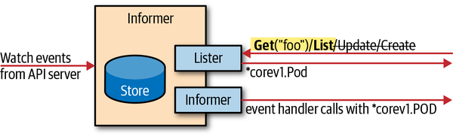
Shared Informers
Shared data cache
Distributes data to all the listeners that are interested in knowing about the change events
Register your handlers
AddFunc
UpdateFunc
DeleteFunc
Alleviates load on the APIServer by allowing multiple controllers to share a single watch to the APIServer
Notes:
informers cause load on the api server, one binary should instantiate only one informer per GroupVersionResource
use sharedinformer as it allows different control loops to use the same watch connection to the api server

Slide 15
Workqueue
A queuing system used by the controller to process events stored in the informer’s DeltaFIFO
Controllers may process work at different rates than the Informer receives change events, so the controller workqueue has different configurations, different rate limiting interfaces, etc.
Generic interface that queue types are derived from
DelayingInterface - add an item at a later time
RateLimitingInterface - extends DelayingInterface
Various rate-limiters available
BucketRateLimiter
ItemExponentialFailureRateLimiter
ItemFastSlowRateLimiter
MaxOfRateLimiter
Most controllers will use DefaultControlRateLimiter() *RateLimiter functions

Slide 16
Reconciliation / Business Logic
Where we implement the logic of our controller
May also interact with the API directly using embedded clients
We do not actually see the object we get the name and namespace from the queue
Changes to resources for which our informers are watching may trigger the processes again

Slide 17
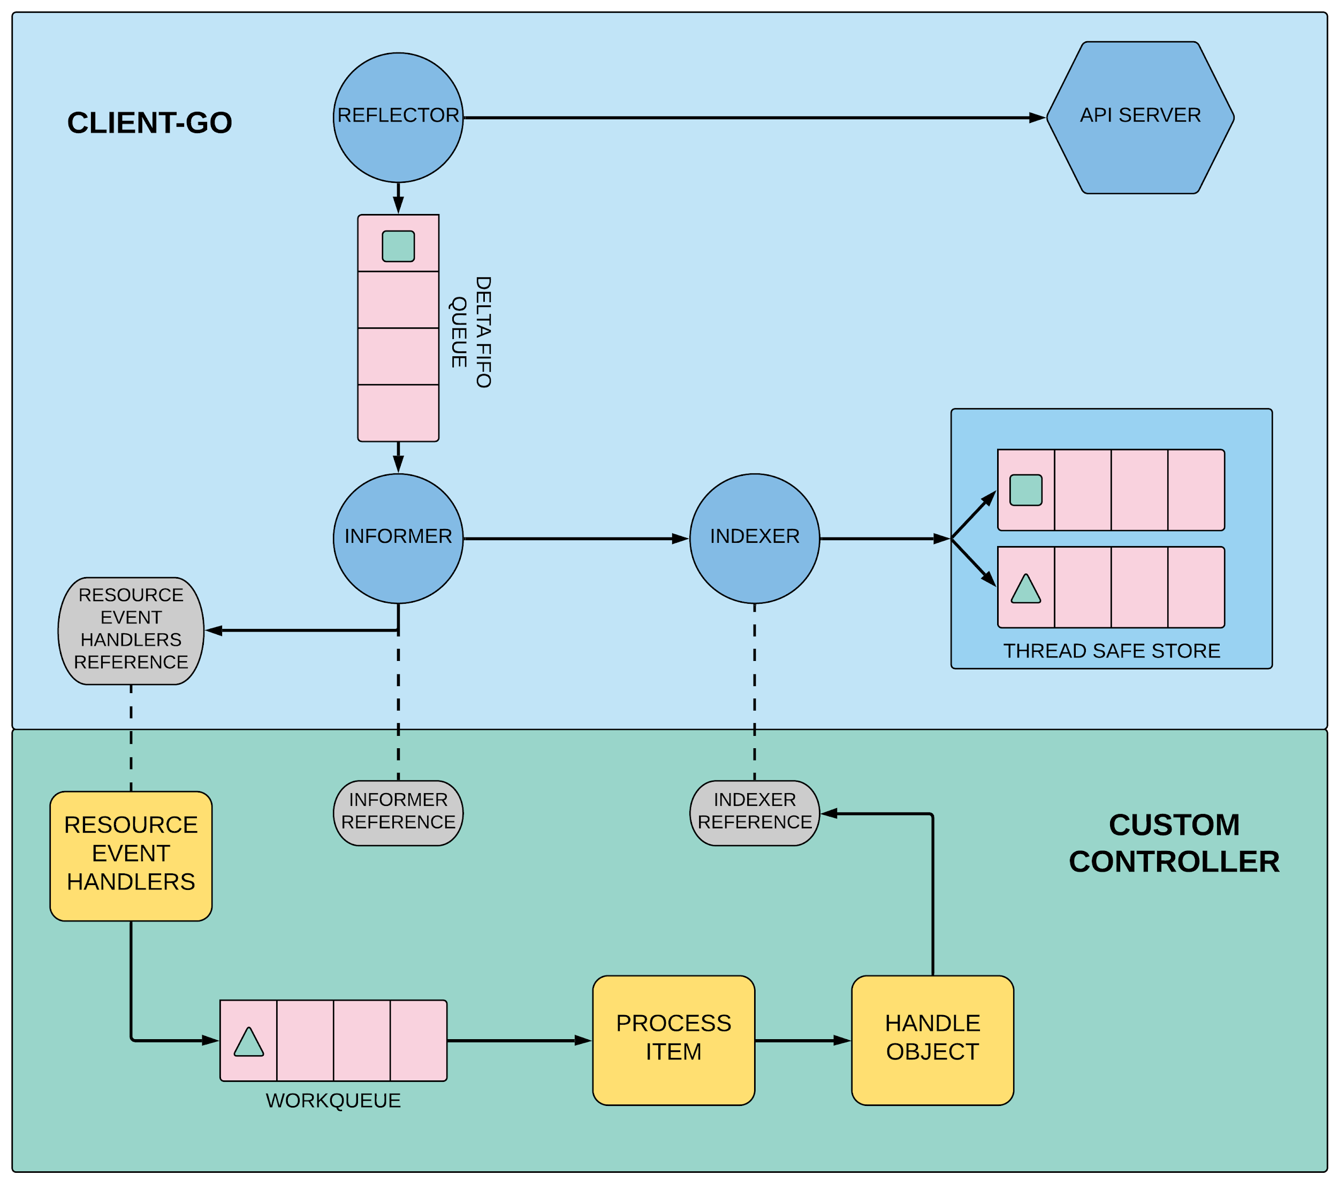
Informers
and Caching
List and Watch
Add Object
Pop Object
Add Object
Store Object and Key
Dispatch Event Handler Functions
Enqueue Object Key
Get Key
Get Object for Key
Programmatically Interacting with the API
1
2
3
4
5
6
9
7
8

Slide 18
Guidelines for Writing Controllers
Operate on one item at a time.
Random ordering between resources.
Level driven, not edge driven.
Use SharedInformers.
Never mutate original objects.
There are other actors in the system.
Percolate errors to the top level for consistent re-queuing.
Watches and Informers will “sync”.
If the primary resource your controller is reconciling supports ObservedGeneration in its status, make sure you correctly set it to metadata.Generation whenever the values between the two fields mismatches.
Consider using owner references for resources that result in the creation of other resources (eg. a ReplicaSet results in creating Pods).
https://github.com/kubernetes/community/blob/master/contributors/devel/sig-api-machinery/controllers.md
https://github.com/kubernetes/community/blob/master/contributors/devel/sig-api-machinery/controllers.md#rough-structure

Slide 19
Questions?

